Slide 1
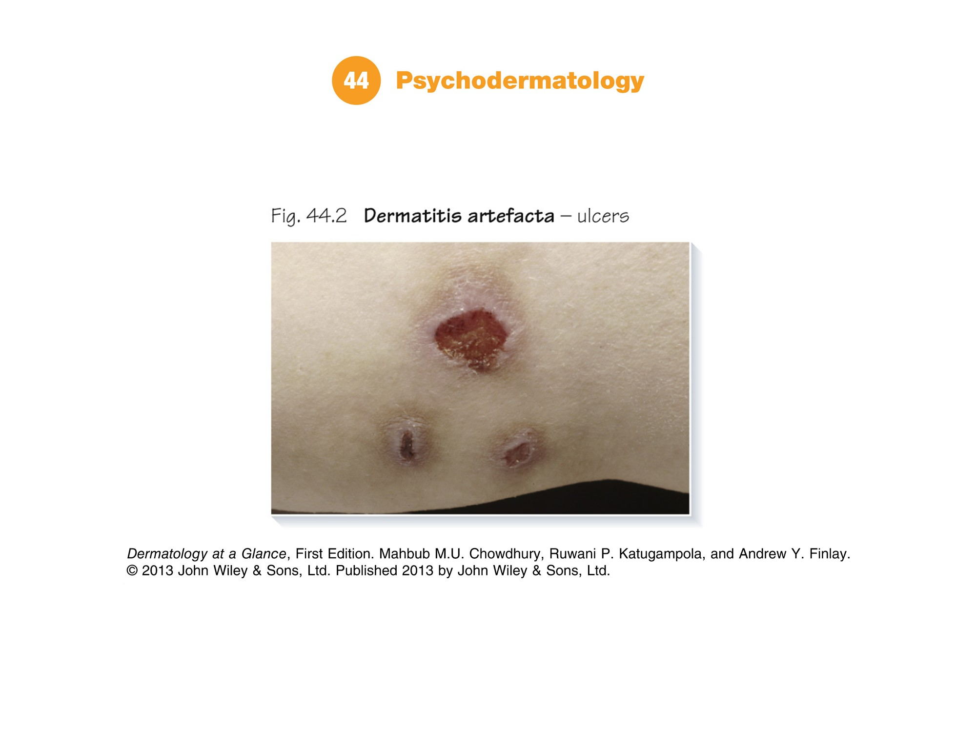
Notes:
Part 14 Miscellaneous conditions
Chapter 44 Psychodermatology | Chapter 45 Skin breakdown | Chapter 46 Hereditary skin diseases

Slide 2
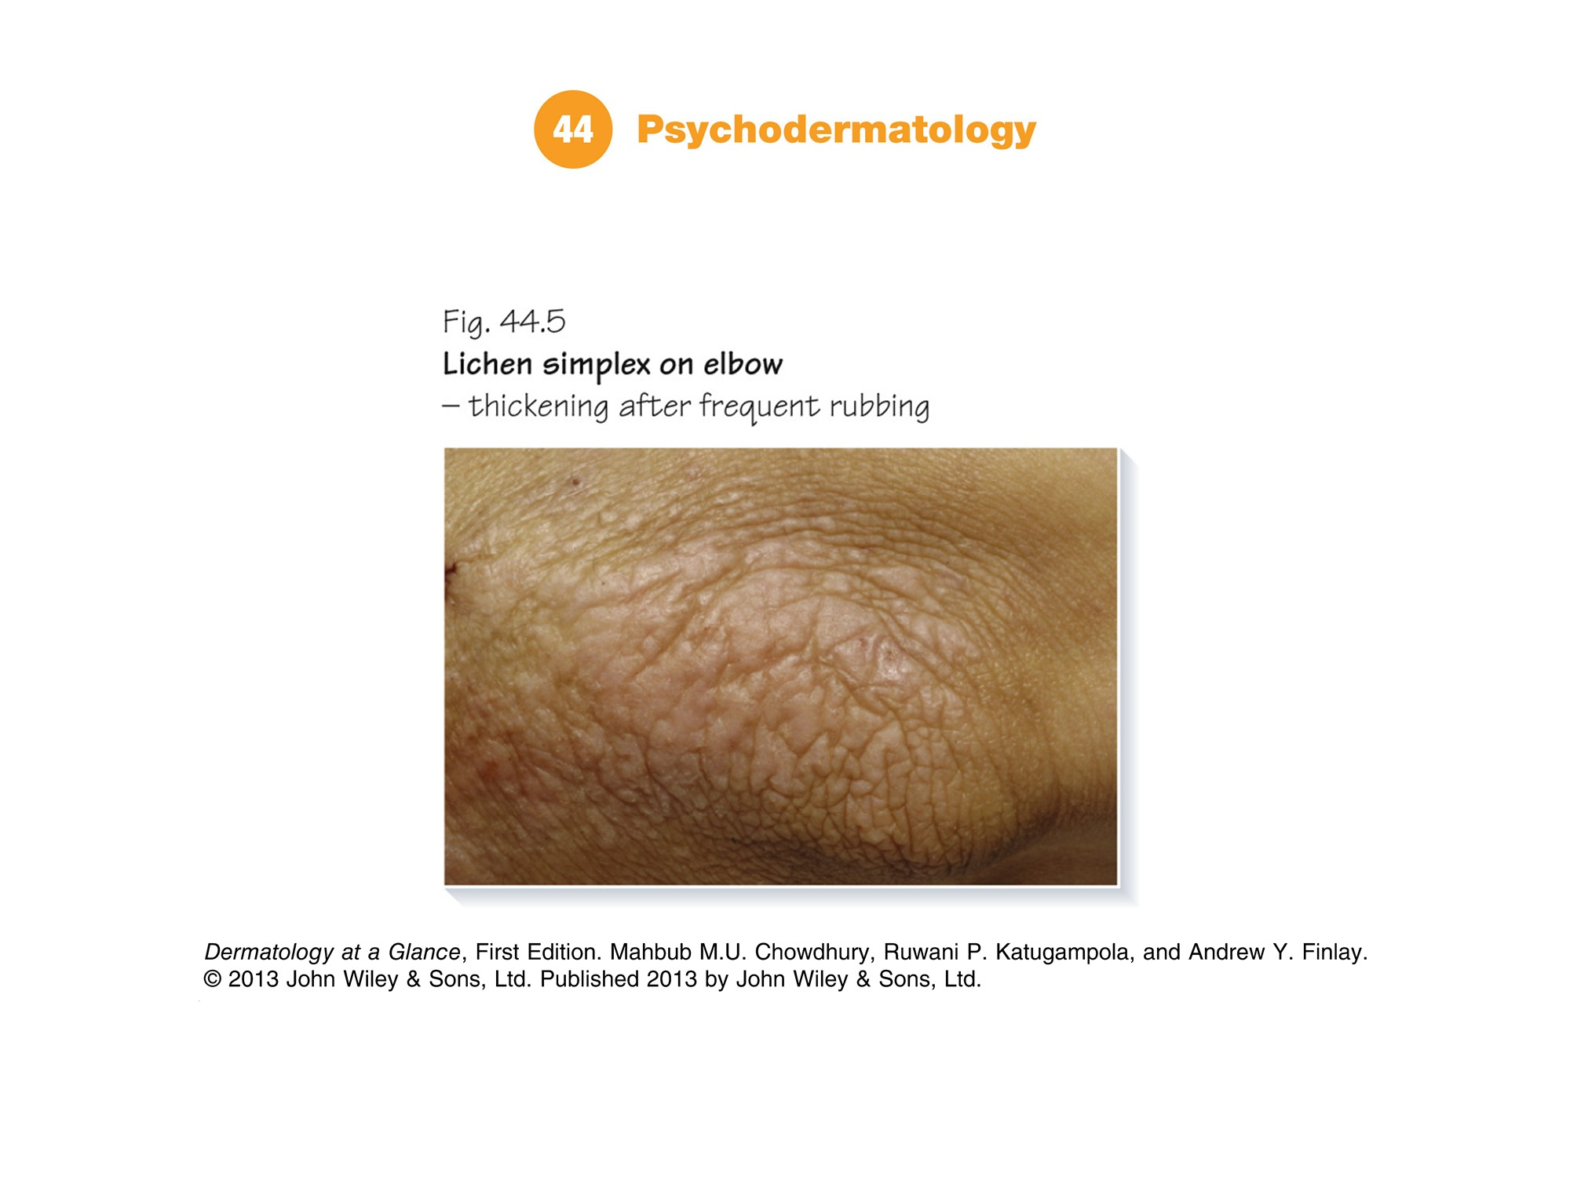

Slide 3
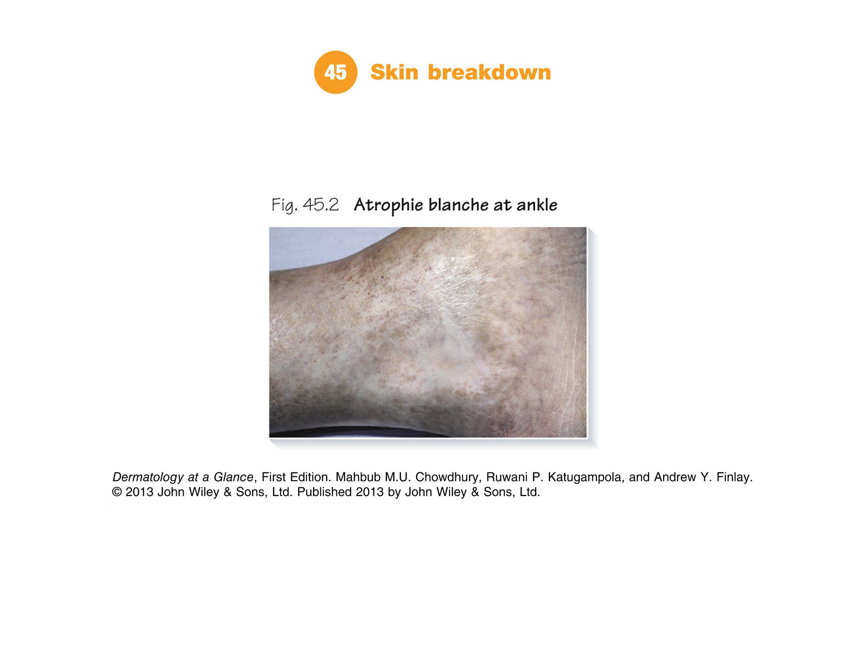

Slide 4
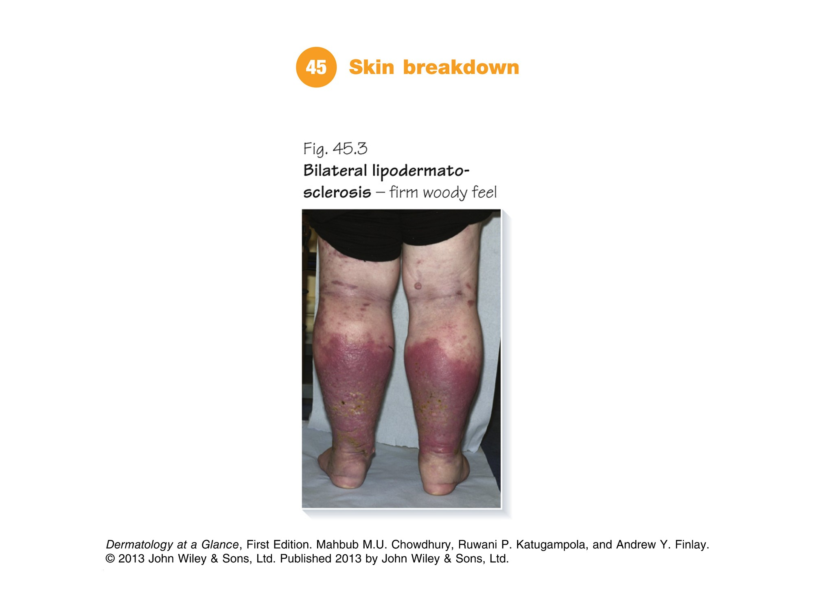

Slide 5
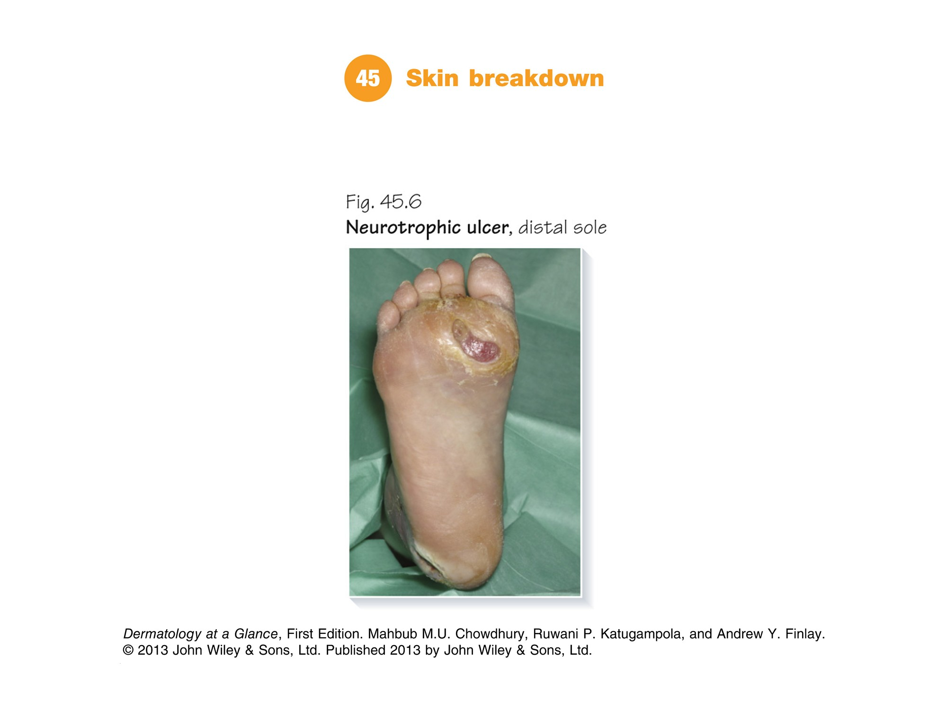

Slide 6
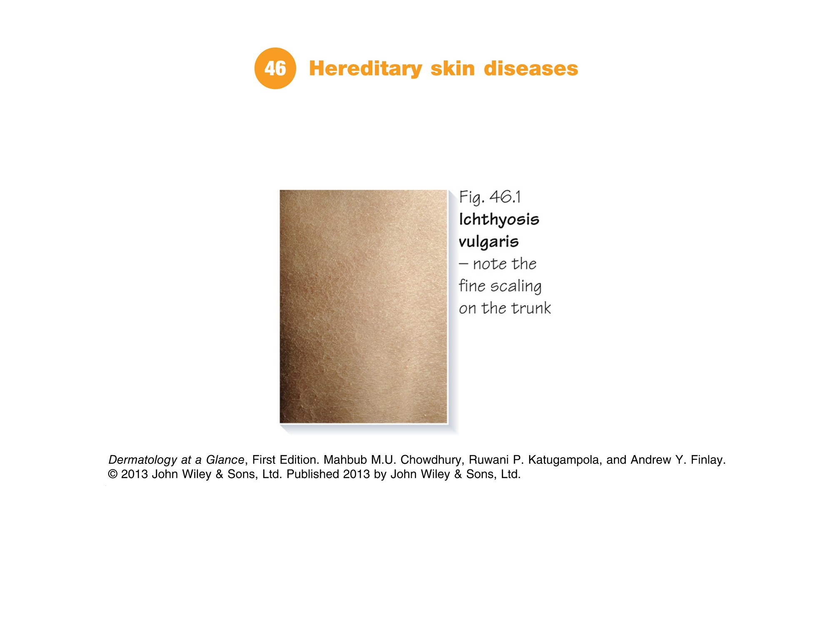

Slide 7
